Slide 1
Spatial Models
AIMS April 1

Slide 2
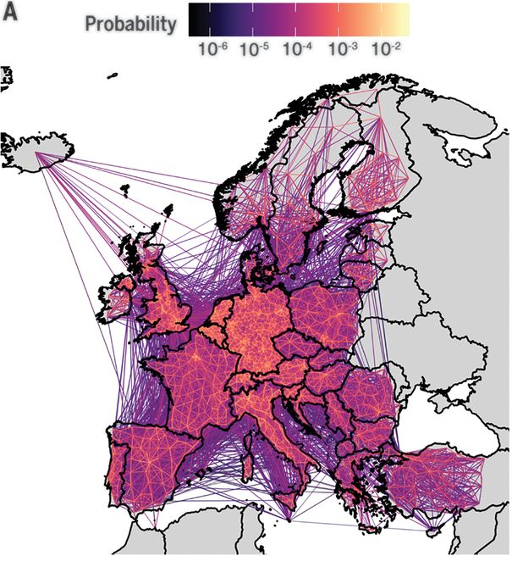
My details
Dr Nick W Ruktanonchai
Population Health Sciences; College of Vet Med
Virginia Tech
nrukt00@vt.edu
Human mobility & infectious disease
How does travel affect where/when infectious diseases spread?

Slide 3
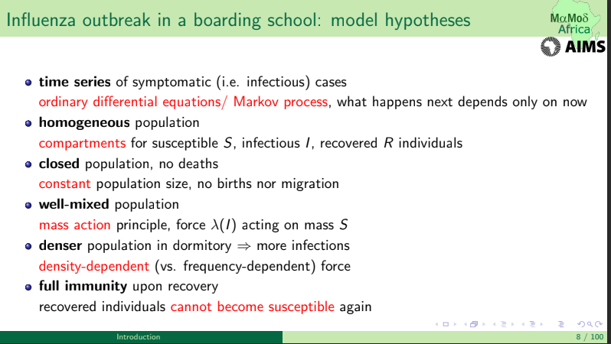

Slide 5
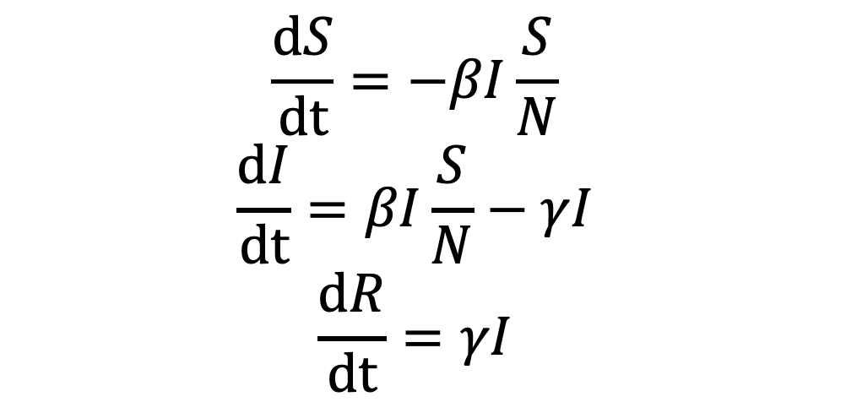
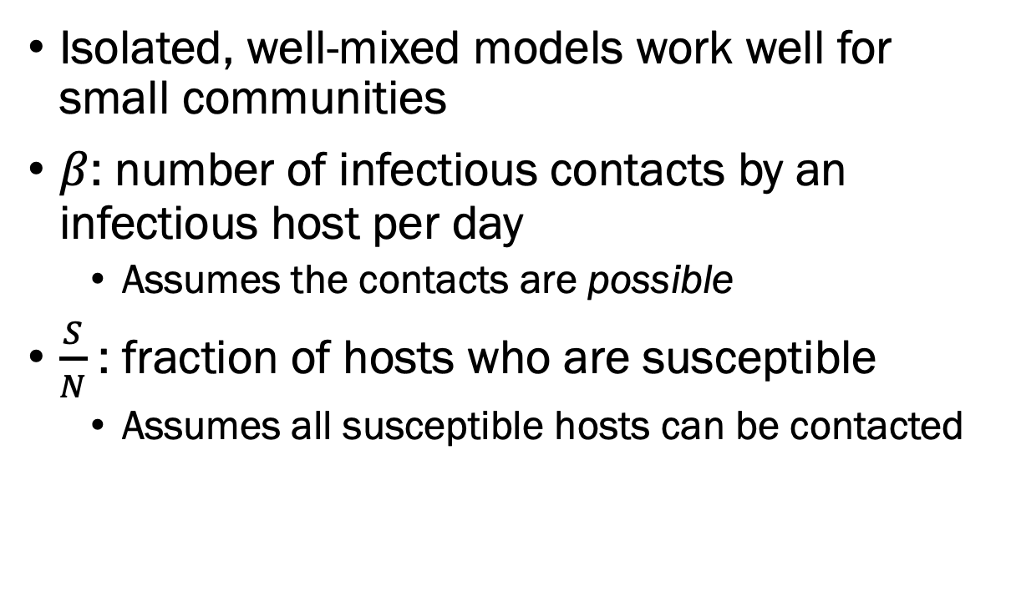
Local population modeling
Isolated, well-mixed models work well for small communities
$β$: number of infectious contacts by an infectious host per day
Assumes the contacts are possible
$\frac{S}{N}$: fraction of hosts who are susceptible
Assumes all susceptible hosts can be contacted
$$\frac{dS}{dt}=−βI\frac{S}{N}$$
$$\frac{dI}{dt}=βI\frac{S}{N}−γI$$
$$\frac{dR}{dt}=γI$$

Slide 6
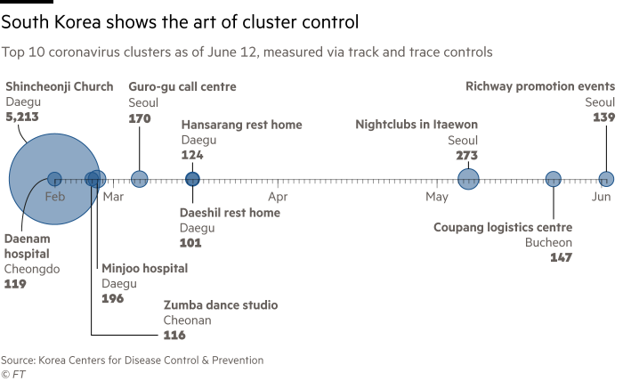
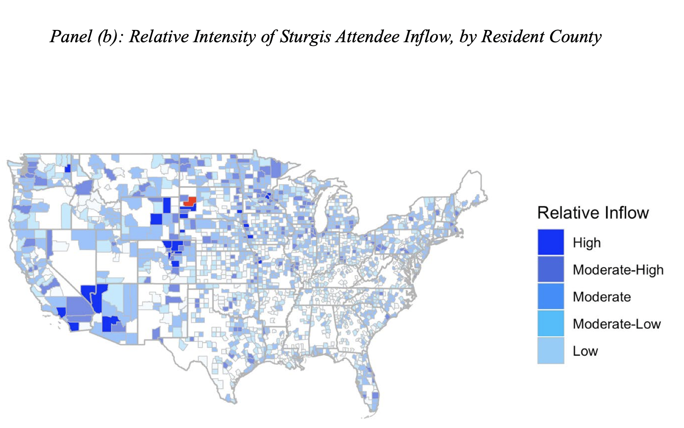
In reality…
Risk is highly localized
Some people/animals are much more likely to contact than others
Depends on travel

Slide 7
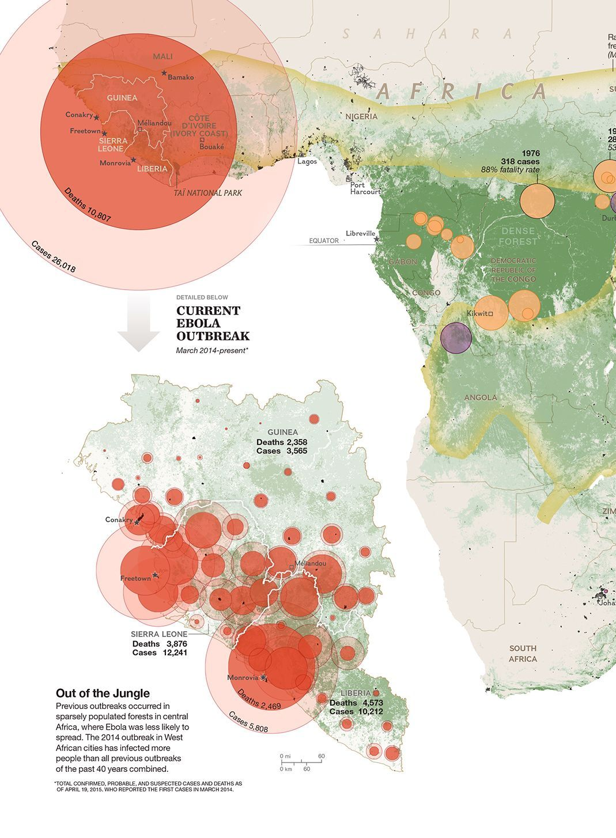
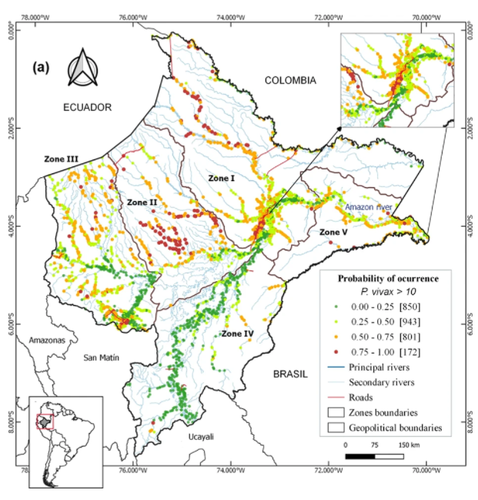
2014 Ebola outbreak
Malaria in Ecuador
https://www.nationalgeographic.org/activity/mapping-spread-disease-community/
https://www.nature.com/articles/s41598-019-51564-4/figures/4

Slide 8
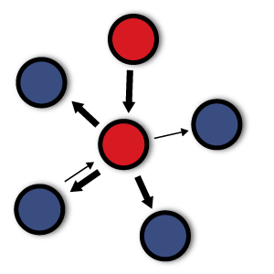
This week
How do we incorporate space into our models?
When should we?
What can we learn from spatial models?
What kinds of analyses do people do?

Slide 9
This week
Work in R: Practice with models that utilize space
Perform various analyses (ie. network analysis), work with real-world data
Read scientific literature on spatial modeling & discuss

Slide 10
Rough agenda
Day 1: Introduction to spatial modeling
Worksheet exploring a metapopulation model
Day 2: Intro continued, and data sources
Worksheet 2: Using Virginia data
Day 3: Other analyses we can perform (source/sink dynamics, network analysis)
Worksheet 3: Network analysis
Day 4: Network analysis
Wrap up worksheets
Day 5: Public health applications & review of key concepts
Discussion on paper readings

Slide 11
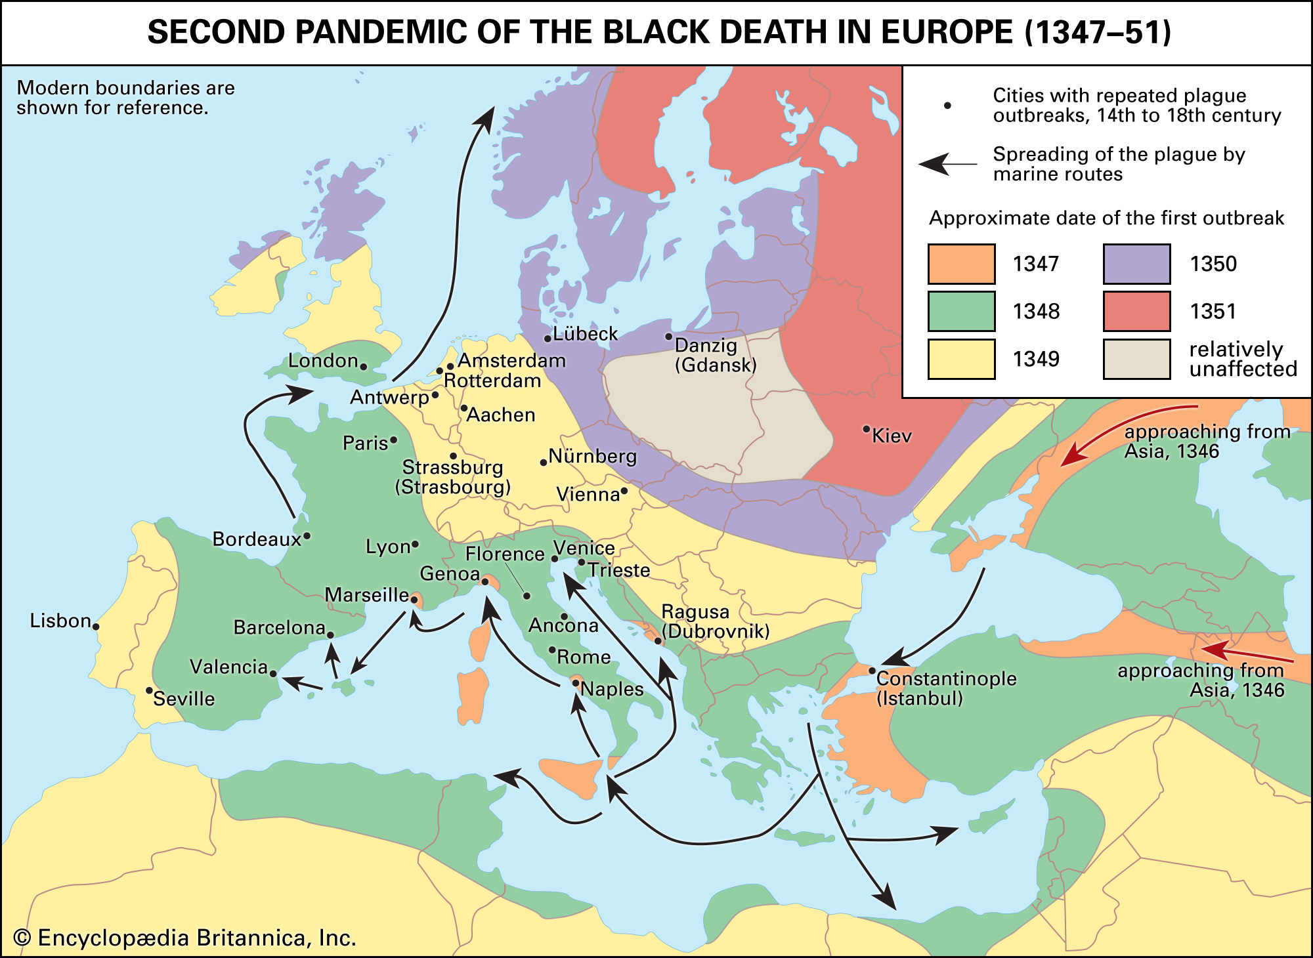
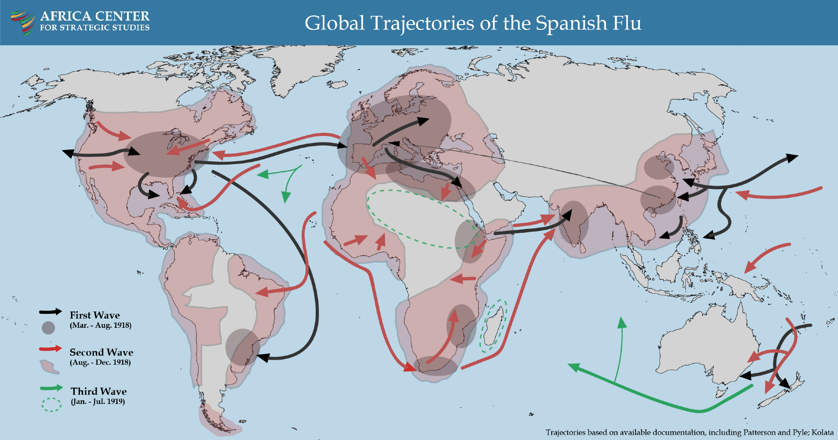
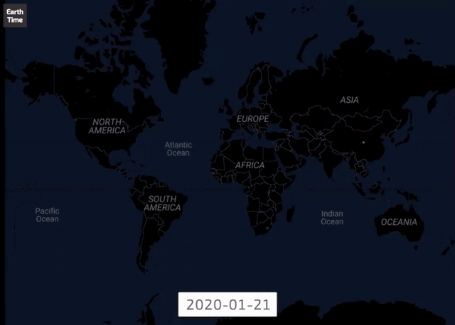
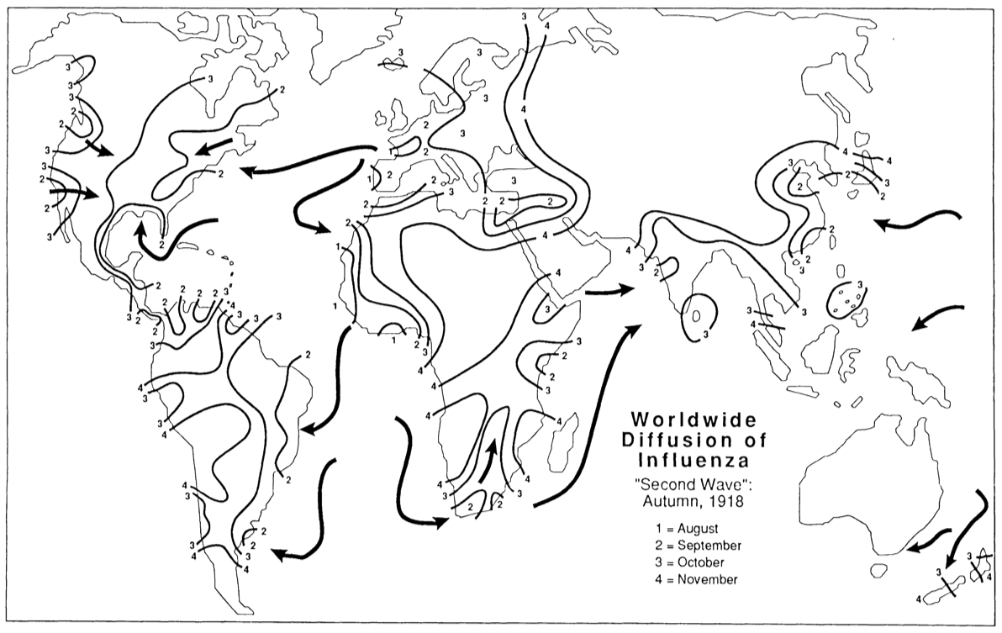

Slide 12
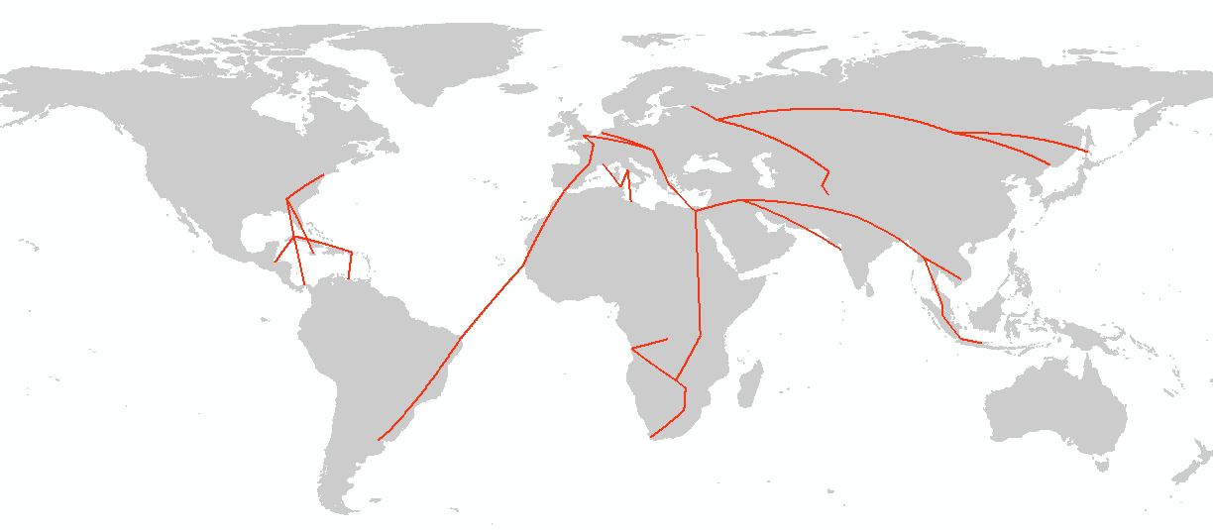
Global air network: 1933
Tatem (2014) Int Health

Slide 13
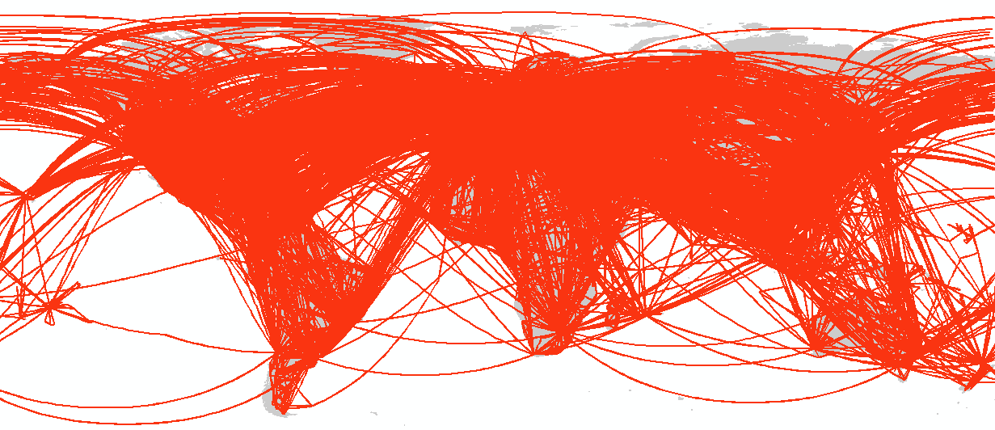
Global air network: Today
Tatem (2014) Int Health

Slide 14
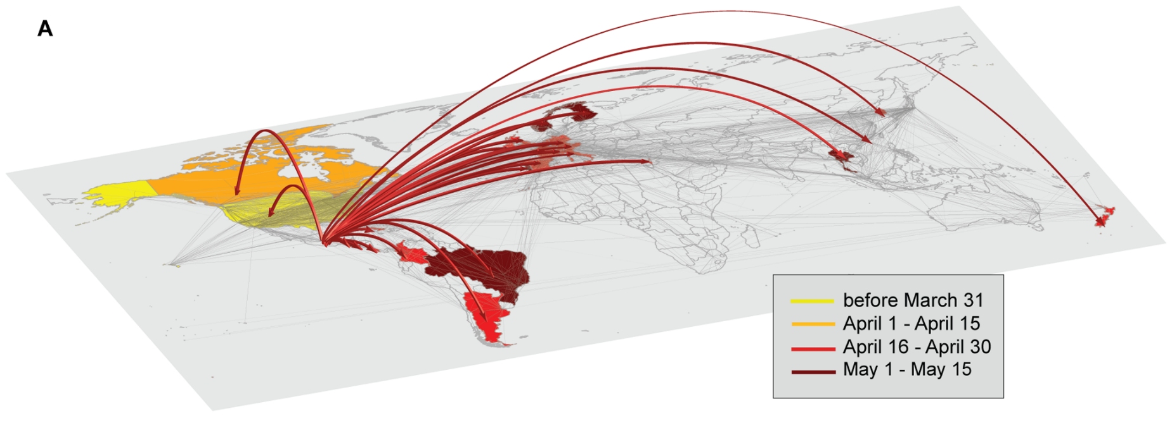
Host movement
Bajardi et al 2011
Host movement is fundamental driver of disease spread/emergence
Individual differences
If someone travels more, more contacts
Spatial differences
Some places host large gatherings

Slide 15
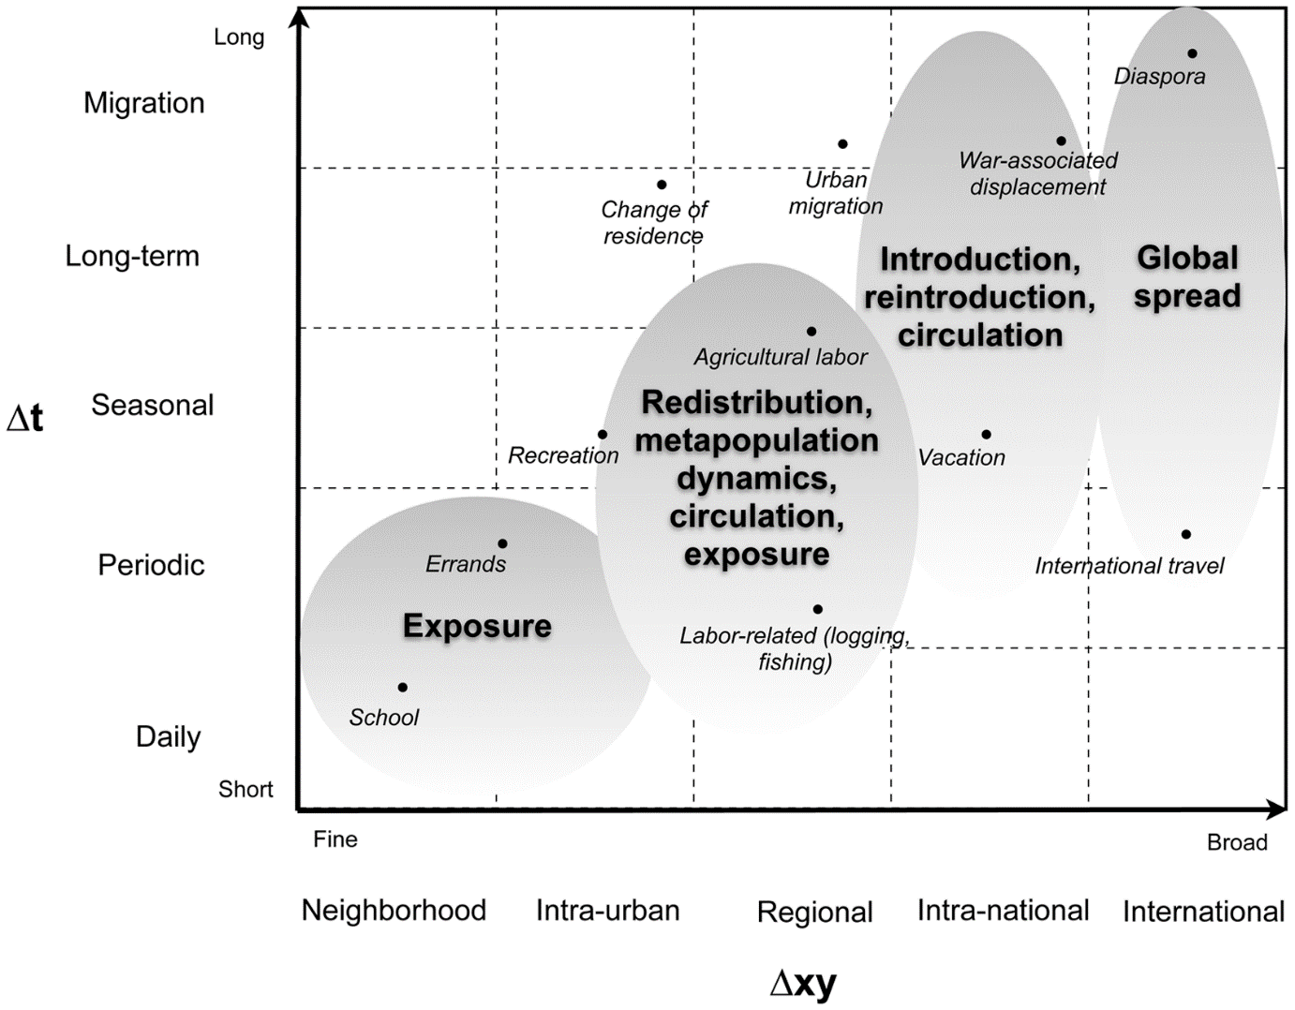
Variance in human mobility
Humans move for many reasons, across scales
Work
Leisure
School
Resources (healthcare, food, etc)
These types of movements manifest in different ways
Long distance, infrequent holiday movement
Stoddard et al 2009. The Role of Human Movement in the Transmission of Vector-Borne Pathogens. PLOS NTDs

Slide 16
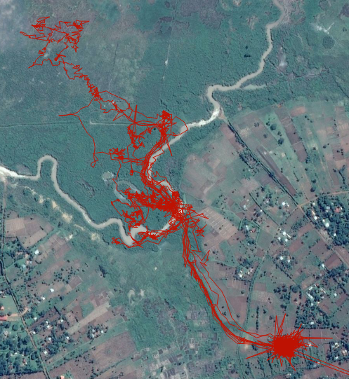
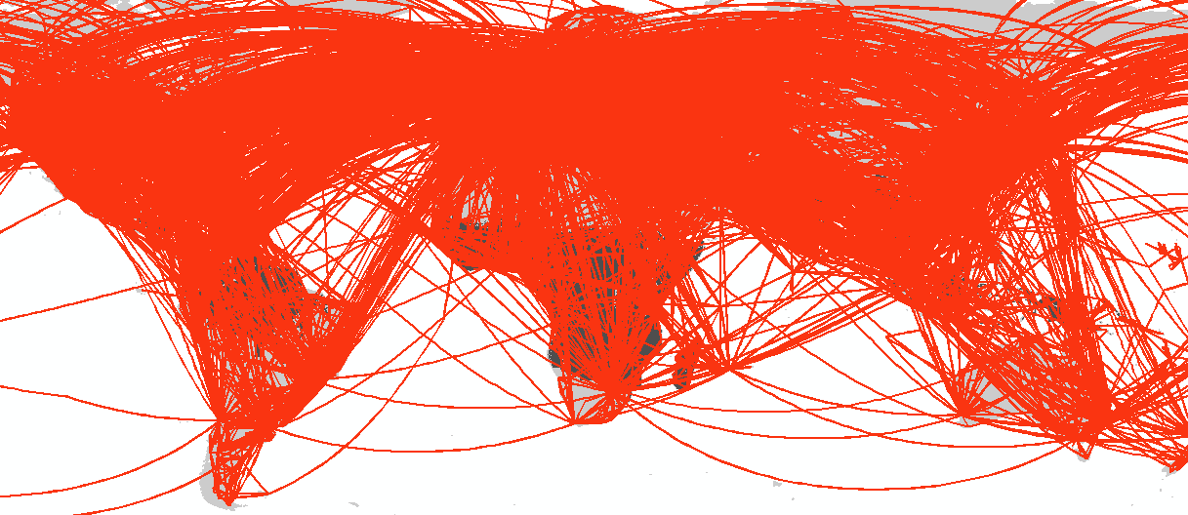
Mobility patterns are important across scales

Slide 17
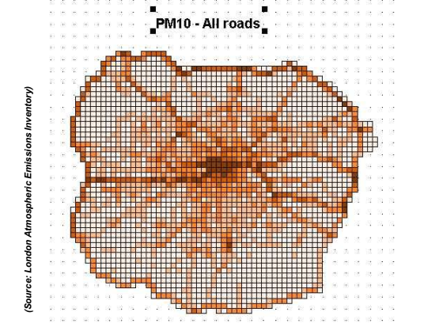

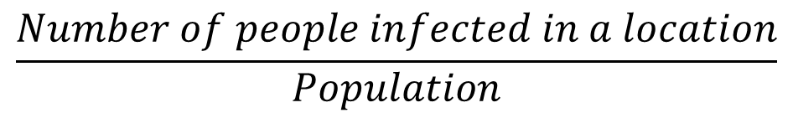
Mobility affects exposure to infectious disease, and in other settings: Incidence rates
Adverse air-pollution related effects:
30 per 1000
Adverse air-pollution related effects:
5 per 1000
$$\frac{Number of people infected in a location}{Population}$$

Slide 18
Mobility affects exposure to infectious disease, and in other settings: Incidence rates
Adverse air-pollution related effects:
30 per 1000
Adverse air-pollution related effects:
5 per 1000

Slide 19

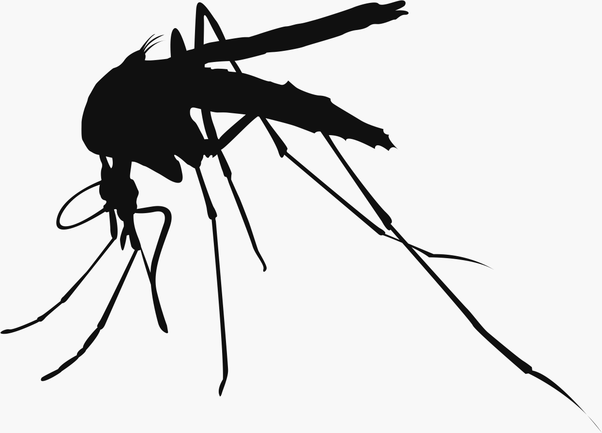



Mobility affects malaria transmission further afield
Malaria hotspot
Distant urban areas
Populated areas near hotspot
Let’s try to codify how malaria moves with humans…

Slide 20

Mobility and malaria
Malaria hotspot
Distant urban areas
Populated areas near hotspot
Step 1: Initial infection

Slide 21
Mobility and malaria
Malaria hotspot
Distant urban areas
Populated areas near hotspot
Step 2: Transit

Slide 22
Mobility and malaria
Malaria hotspot
Distant urban areas
Populated areas near hotspot
Step 3: Onward transmission

Slide 23
Mobility and malaria
Malaria hotspot
Distant urban areas
Populated areas near hotspot
Onward transmission can continue further afield

Slide 24
Mobility and malaria
Malaria hotspot
Distant urban areas
Populated areas near hotspot
In different areas, different types of movement causes this (migration vs. circulatory)

Slide 25
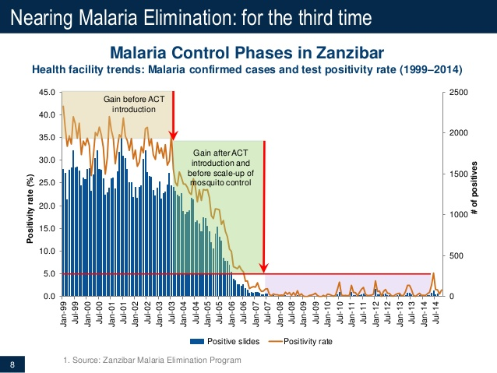
Human mobility and control

Slide 26
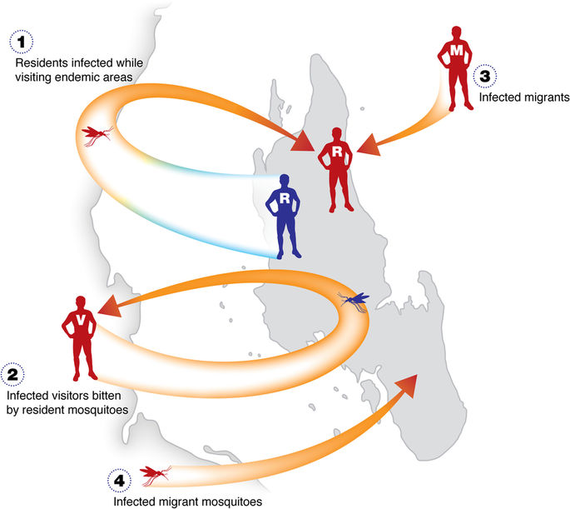
Human mobility and control

Slide 27
Possible interventions
Malaria hotspot
Distant urban areas
Populated areas near hotspot
During travel
Screening at health facilities
In populated areas
Screening, follow-up case management
At site of initial infection
Vector control, bednets

Slide 28
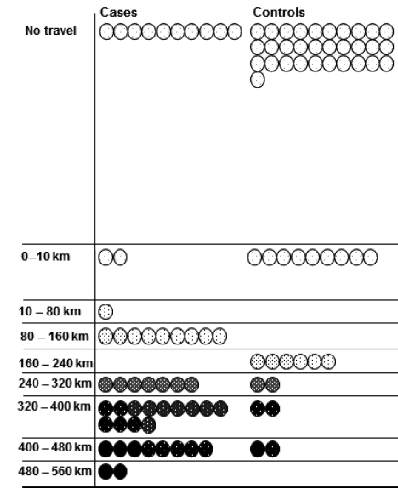
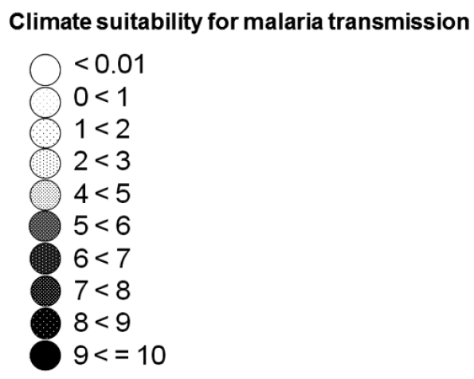
An example: Ugandan Highlands
How much does travel contribute to transmission in highland and highland fringe areas?
Patients who had travelled to areas of higher transmission intensity than their home areas recently were nearly seven times more likely to have confirmed malaria
Lynch et al (2015) Trop Med Int Health

Slide 29
Human mobility, infectious disease, and spatial disease modeling
People move pathogens between communities/areas
Creates interesting dynamics that can be explored using mathematical modelling approaches
Source/sink dynamics
Persistence/extinction
Optimal control

Slide 30
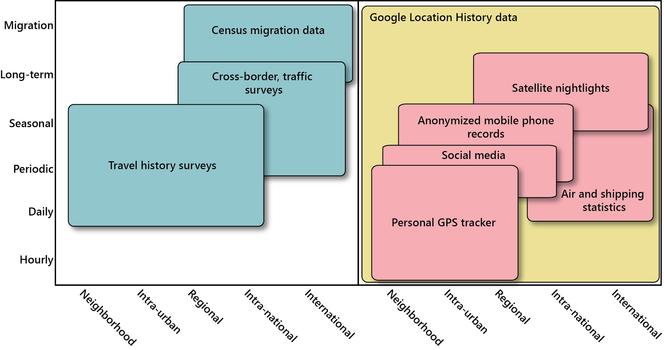
How can we account for space and mobility?
Many different types of movement data available
Inform different aspects of mobility—important for different problems

Slide 31
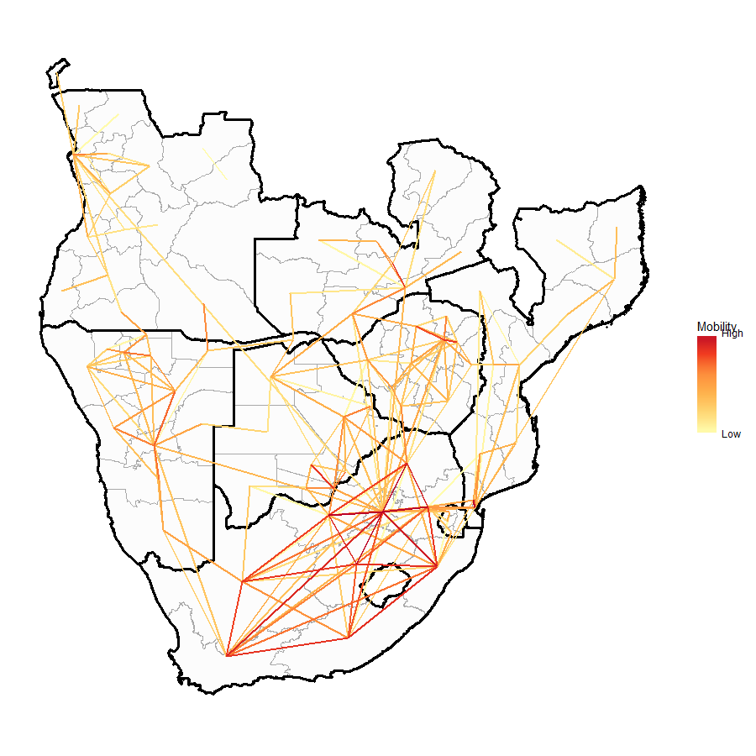
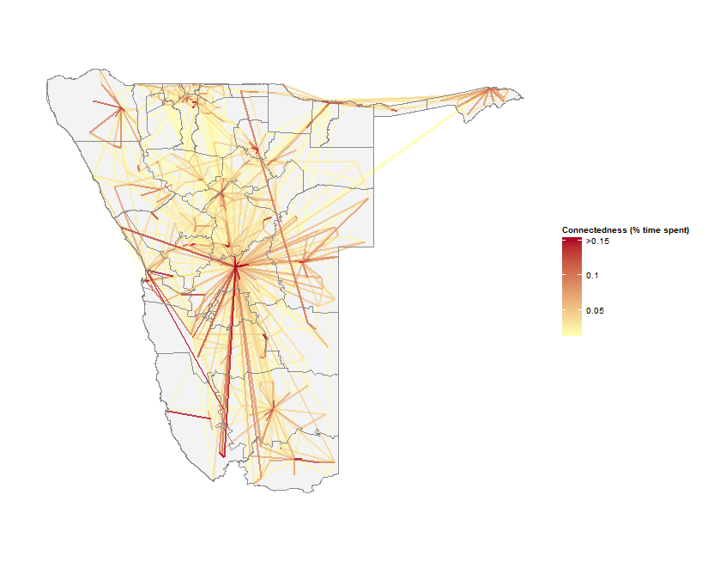
Census
Mobile phone
Each dataset has pros, cons (Some include daily, monthly information)
Seek to merge these into a believable,
regional-scale map of mobility
Smartphones

Slide 32
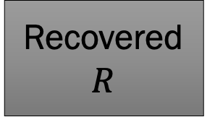
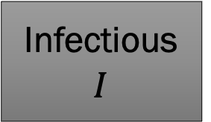
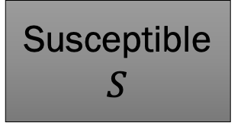
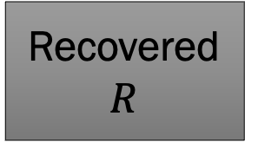
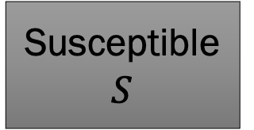
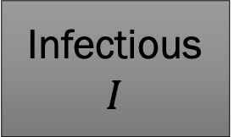
How do we model space?
First, different S/I/R classes for each area
“Patches” could represent towns, states, countries…
Cross-community transmission exists
Susceptible $S$
Infectious $I$
Recovered $R$
Susceptible $S$
Infectious $I$
Recovered $R$

Slide 33
Cross-community transmission
Two types of “cross-community” transmission
Infectious people in one patch contact susceptible people in another
Cross-community transmission will be much lower
Susceptible $S$
Infectious $I$
Recovered $R$
Susceptible $S$
Infectious $I$
Recovered $R$

Slide 34
Cross-community transmission
Another option:
Transmission only happens within the community
People move physically between them
When would you use one over another?
Susceptible $S$
Infectious $I$
Recovered $R$
Susceptible $S$
Infectious $I$
Recovered $R$

Slide 35

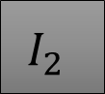
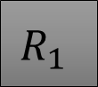

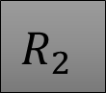


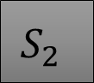

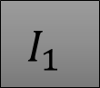


$$S_{1}$$
$$I_{1}$$
$$R_{1}$$
$$S_{1}$$
$$I_{1}$$
$$R_{1}$$
$$S_{2}$$
$$I_{2}$$
$$R_{2}$$
$$S_{2}$$
$$I_{2}$$
$$R_{2}$$
We move people physically from one area to another
Some S1 individuals move to patch 2 and become S2, etc
Transmission only occurs within patch
I2 individuals can only infect S2
People always stay in the same place
Cross-community transmission occurs
I2 can infect S1, but probably at a much lower contact rate than I2 to S2

Slide 36
$$S_{1}$$
$$I_{1}$$
$$R_{1}$$
$$S_{1}$$
$$I_{1}$$
$$R_{1}$$
$$S_{2}$$
$$I_{2}$$
$$R_{2}$$
$$S_{2}$$
$$I_{2}$$
$$R_{2}$$
We move people physically from one area to another
Some S1 individuals move to patch 2 and become S2, etc
Transmission only occurs within patch
I2 individuals can only infect S2
People always stay in the same place
Cross-community transmission occurs
I2 can infect S1, but probably at a much lower contact rate than I2 to S2
“Eulerian” movement
“Lagrangian” movement

Slide 37
What are some good reasons to consider using a spatial model?
http://bit.ly/aims_spatial_models
$$S_{1}$$
$$I_{1}$$
$$R_{1}$$
$$S_{1}$$
$$I_{1}$$
$$R_{1}$$
$$S_{2}$$
$$I_{2}$$
$$R_{2}$$
$$S_{2}$$
$$I_{2}$$
$$R_{2}$$
We move people physically from one area to another
Some S1 individuals move to patch 2 and become S2, etc
Transmission only occurs within patch
I2 individuals can only infect S2
People always stay in the same place
Cross-community transmission occurs
I2 can infect S1, but probably at a much lower contact rate than I2 to S2
“Eulerian” movement
“Lagrangian” movement

Slide 38
$$S_{1}$$
$$I_{1}$$
$$R_{1}$$
$$S_{1}$$
$$I_{1}$$
$$R_{1}$$
$$S_{2}$$
$$I_{2}$$
$$R_{2}$$
$$S_{2}$$
$$I_{2}$$
$$R_{2}$$
We choose one or another based on the type of movement we observe
We move people physically from one area to another
Some S1 individuals move to patch 2 and become S2, etc
Transmission only occurs within patch
I2 individuals can only infect S2
People always stay in the same place
Cross-community transmission occurs
I2 can infect S1, but probably at a much lower contact rate than I2 to S2
“Eulerian” movement
“Lagrangian” movement

Slide 39
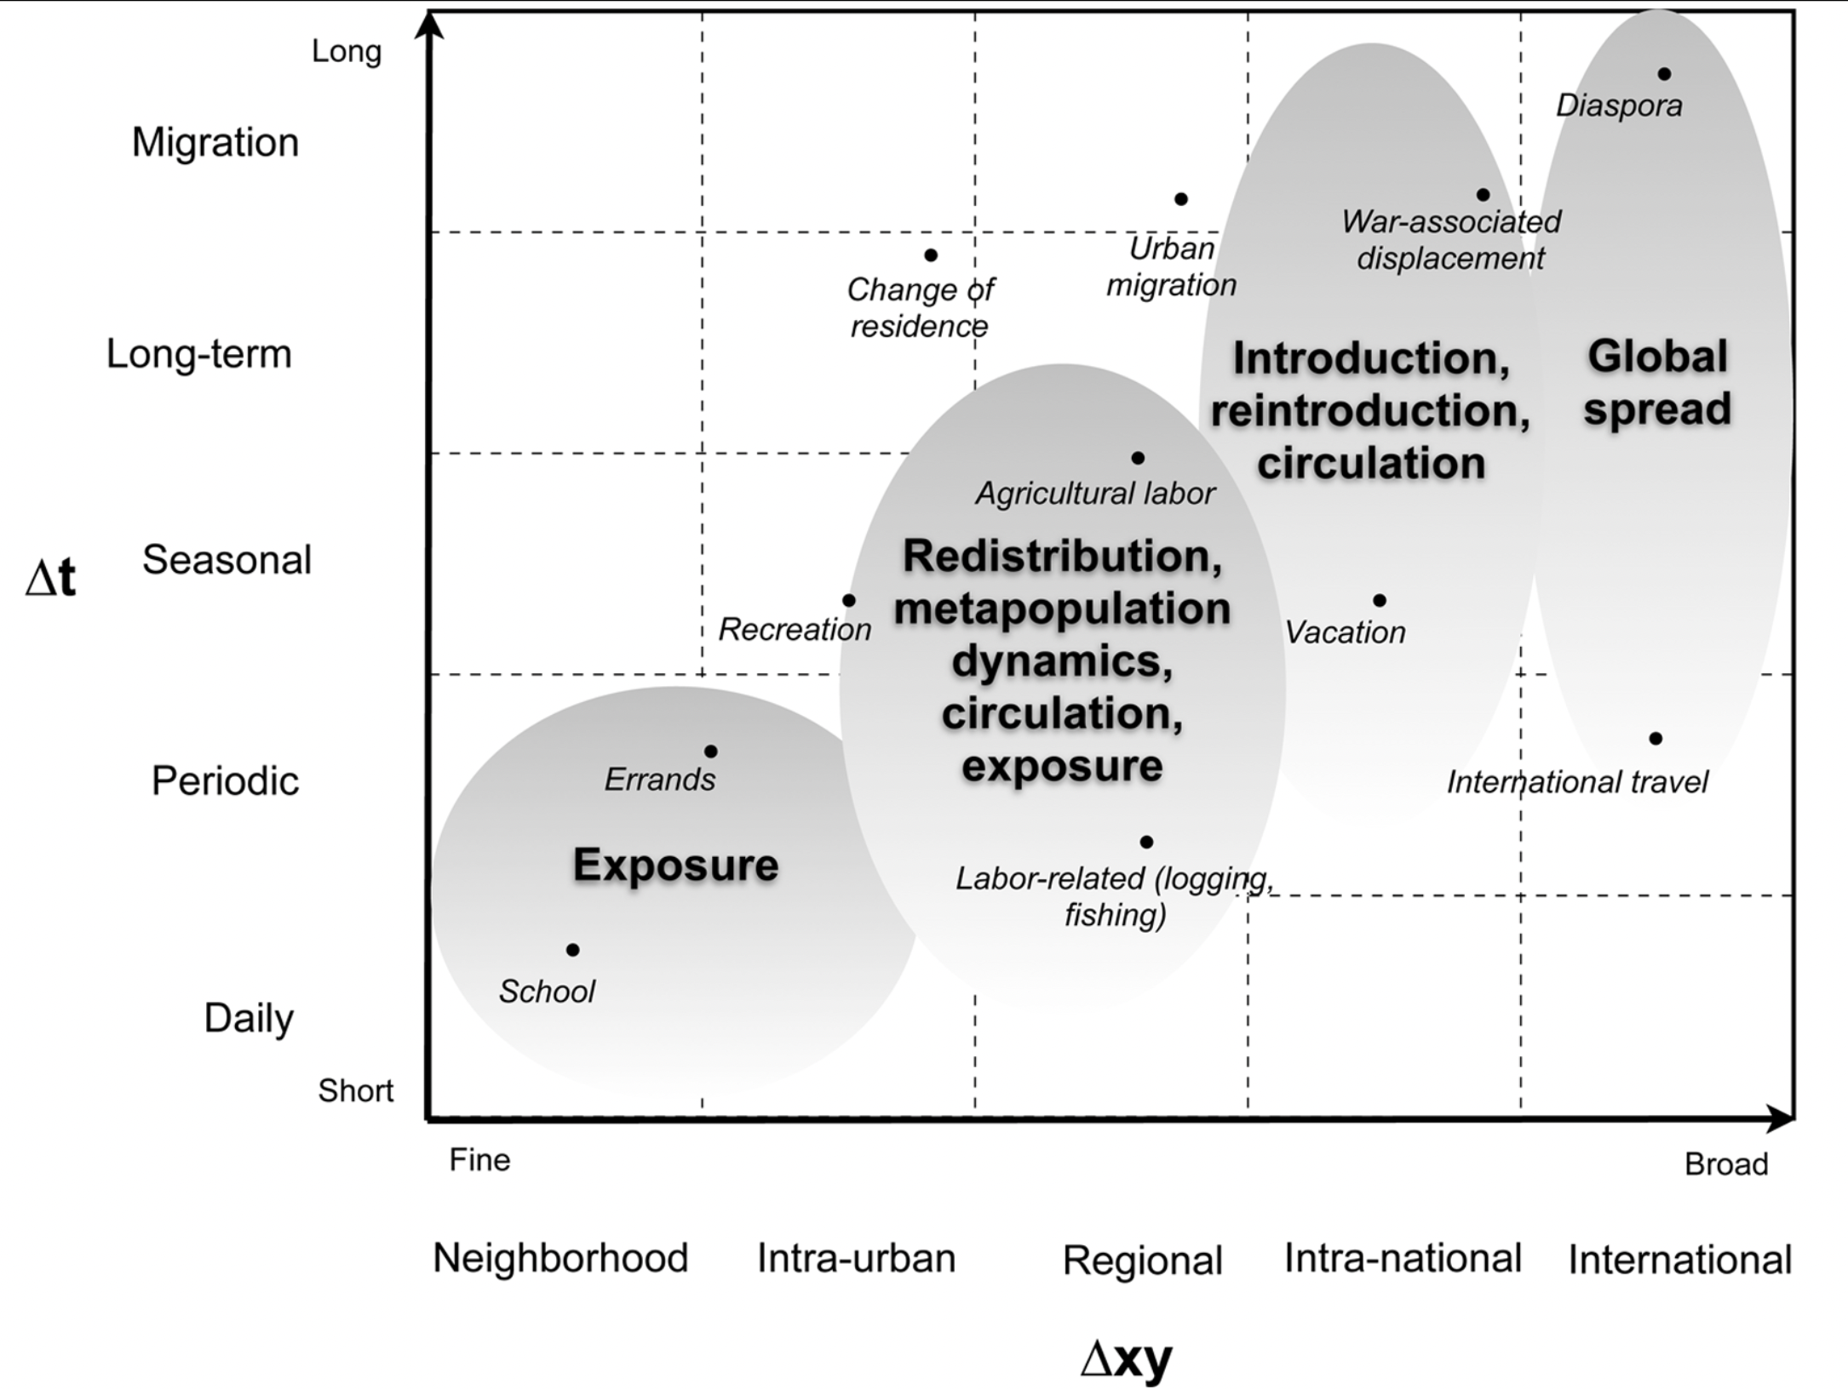
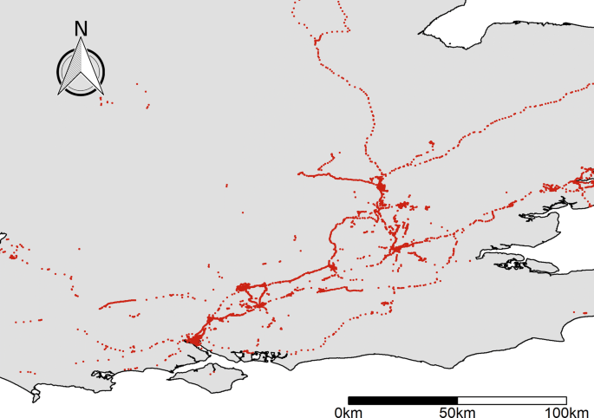
Types of mobility
Varies in reason, distance, type of location visited, frequency

Slide 40
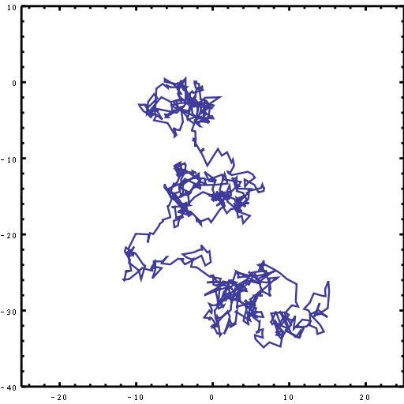
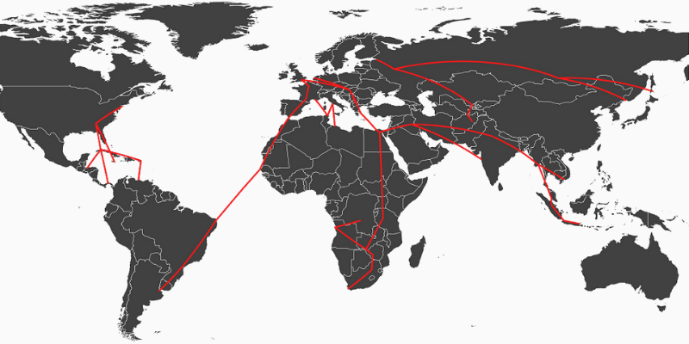
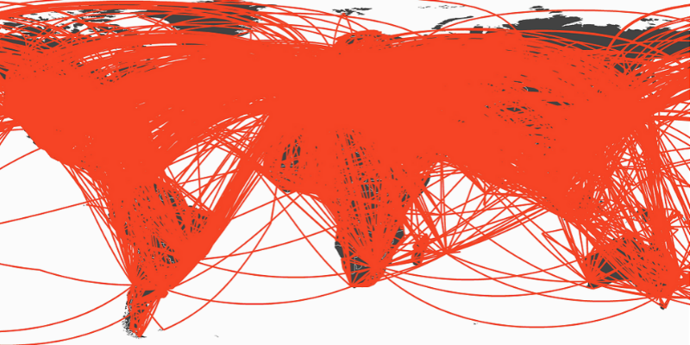
Mobility
People usually move short distances rare longer distance movement
Long distance more common nowadays, though!
1933
2010

Slide 41
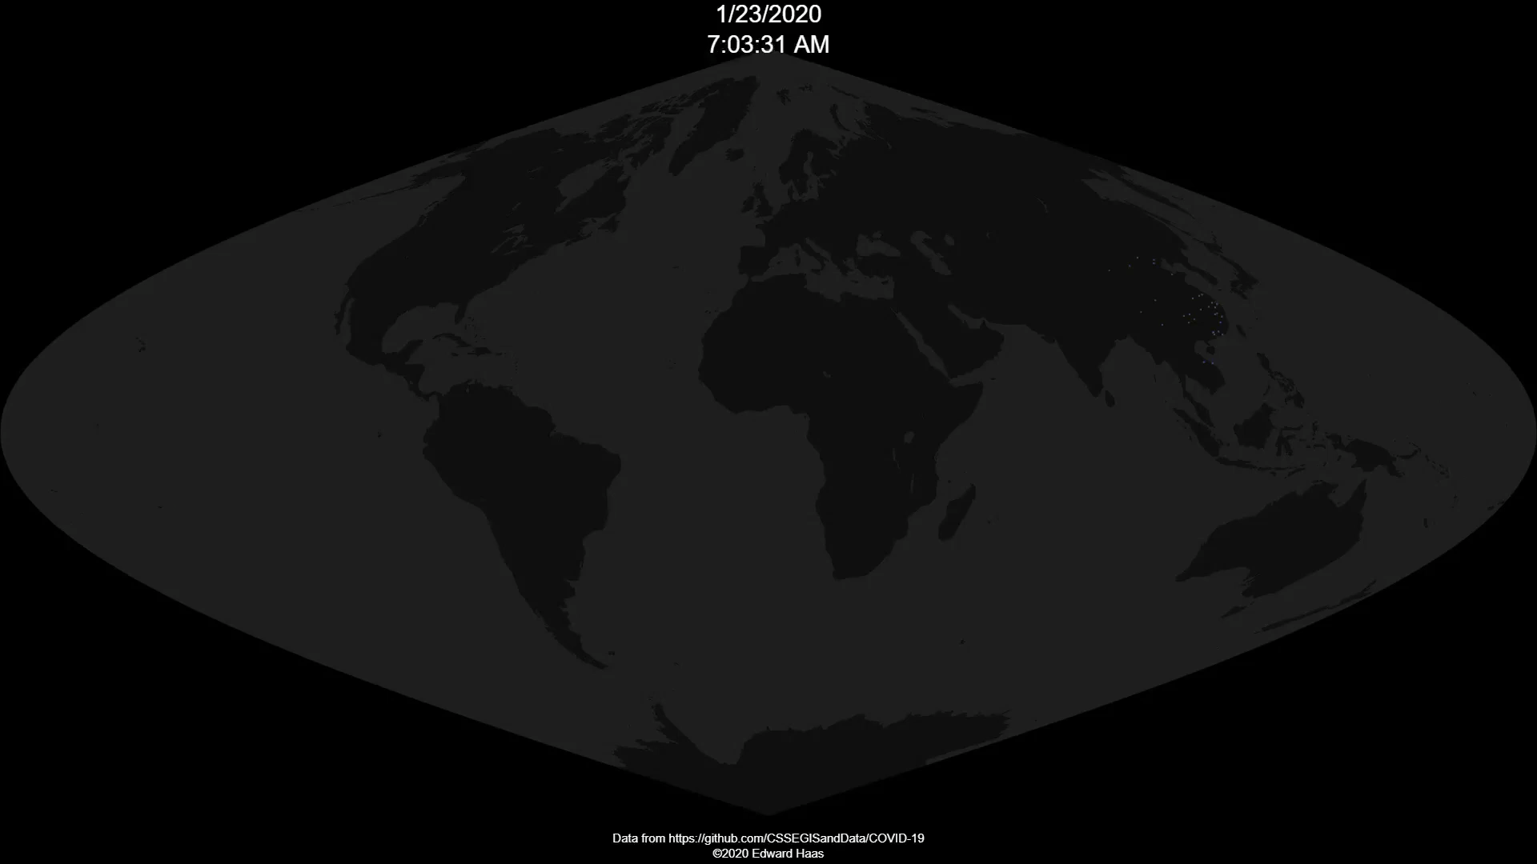

Slide 42
How do we classify it for modeling?
Two common ways to consider movement:
Moving to a new place: “Migration”
Being exposed to a new place, but going back home at the end of the day: “Exposure”

Slide 43
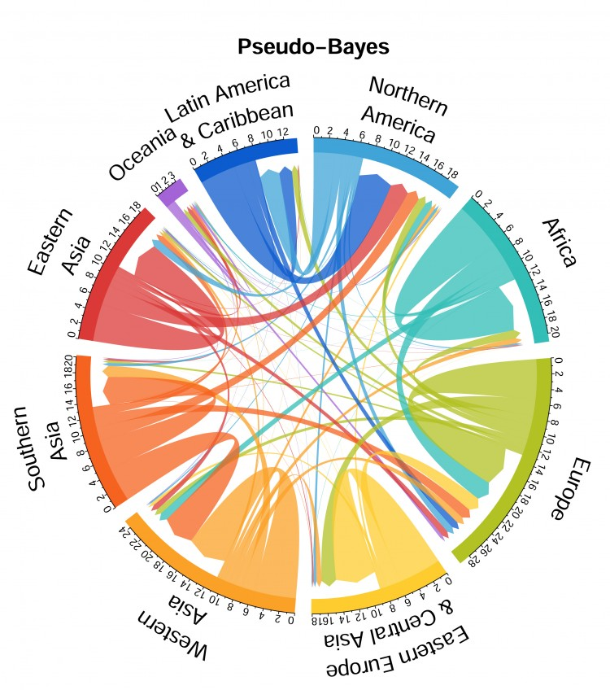
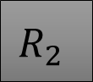
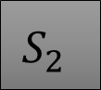




Moving to a new place
Migration is related to Lagrangian-type movement
Move to a new location, and then spend some time there
Physically moving individuals from one place to another
Longer-distance mobility, rarer
$$S_{1}$$
$$I_{1}$$
$$R_{1}$$
$$S_{2}$$
$$I_{2}$$
$$R_{2}$$

Slide 44
Moving to a new place
Susceptible
Infected

Slide 45
Moving to a new place
Susceptible
Infected

Slide 46
Moving to a new place
Susceptible
Infected

Slide 47
Moving to a new place
Susceptible
Infected

Slide 48
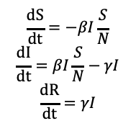


Moving to a new place
Susceptible
$$\frac{dS}{dt}=−βI\frac{S}{N}$$
$$\frac{dI}{dt}=βI\frac{S}{N}−γI$$
$$\frac{dR}{dt}=γI$$
Infected
$$\frac{dS}{dt}=−βI\frac{S}{N}$$
$$\frac{dI}{dt}=βI\frac{S}{N}−γI$$
$$\frac{dR}{dt}=γI$$
$$\frac{dS}{dt}=−βI\frac{S}{N}$$
$$\frac{dI}{dt}=βI\frac{S}{N}−γI$$
$$\frac{dR}{dt}=γI$$

Slide 49


Modifying our model for migration
Each population (S/I/R) moves to new patches at a rate
$m_{21}$: Numbers of people, per person, per day moving from patch 1 to patch 2
Consider movement into as well
$m_{12}$: Numbers of people, per person, per day moving from patch 2 to patch 1
$$\frac{dS_{1}}{dt}=−βI_{1}\frac{S_{1}}{N_{1}}$$
$$\frac{dI_{1}}{dt}=βI_{1}\frac{S_{1}}{N_{1}}−γI_{1}$$
$$\frac{dR_{1}}{dt}=γI_{1}$$

Slide 50

Moving to a new place
Transmission as usual, but people move in and out (staying in the same class)
$\frac{dS_{1}}{dt}=−βI_{1}\frac{S_{1}}{N_{1}}+m_{12}S_{2}−m_{21}S_{1}$

Slide 51

Moving to a new place
Transmission as usual, but people move in and out (staying in the same class)
$\frac{dS_{1}}{dt}=−βI_{1}\frac{S_{1}}{N_{1}}+m_{12}S_{2}−m_{21}S_{1}$
Moving in
Moving out
$m_{12}$=.1 means .1 person moves from 2 to 1 per day
Also means people stay in patch 2 for 1/.1, or 10 days, on average

Slide 52

Moving to a new place
$$\frac{dS_{1}}{dt}=−βI_{1}\frac{S_{1}}{N_{1}}+m_{12}S_{2}−m_{21}S_{1}$$
$$\frac{dI_{1}}{dt}=βI_{1}\frac{S_{1}}{N_{1}}−γI_{1}+m_{12}I_{2}−m_{21}I_{1}$$
$$\frac{dR_{1}}{dt}=γI_{1}+m_{12}R_{2}−m_{21}R_{1}$$
$$\frac{dS_{2}}{dt}=−βI_{2}\frac{S_{2}}{N_{2}}+m_{21}S_{1}−m_{12}S_{2}$$
$$\frac{dI_{2}}{dt}=βI_{2}\frac{S_{2}}{N_{2}}−γI_{1}+m_{21}I_{1}−m_{12}I_{2}$$
$$\frac{dR_{2}}{dt}=γI_{2}+m_{21}R_{1}−m_{12}R_{2}$$
Note movers always stay the same class: I moves to I, R to R, etc

Slide 53






Flow diagram: Migration mobility
Susceptible $S_{1}$
Infectious $I_{1}$
Recovered $R_{1}$
Susceptible$S_{2}$
Infectious$I_{2}$
Recovered$R_{2}$
People can move between areas, but not change state when moving

Slide 54
Worksheet
Introduction to a theoretical metapopulation model
What happens when you have import/export of infected people?

